Slide 1
System Development Methods CT00046-3-2
People Oriented Methodologies

Slide 2
Topic & Structure of the Lesson
People Oriented Methodologies
Web Information Systems Development Methodology (WISDM)
Knowledge Acquisition and Documentation Structuring (KADS)
Soft Systems Methodology (SSM)

Slide 3
Learning Outcomes
By the end of this lecture, YOU should be able to :
Identify and explain the underlying people based methodologies

Slide 4
Key Terms you must be able to use
If you have mastered this topic, you should be able to use the following terms correctly in your assignments and exams:
People Oriented Methodologies and Principles
Web Information Systems Development Methodology (WISDM)
Knowledge Acquisition and Documentation Structuring (KADS)
Soft Systems Methodology (SSM)

Slide 5
People Oriented Methodologies
These methodologies are used when;
Developer trying to make the system mimic the user’s needs and behaviors.
The System is going to be used by many types of users (age, literacy, culture, needs, etc.)
Widely used in environment involving gaming, robotics, virtual reality, augmented reality, medicine, animal behaviors, etc.
Used when:-
Requirements are not fixed / cannot be fully determined earlier
Requirements and scenario is constantly changing.
Structured methodologies might not be suitable as they require many facts to be constant.

Slide 6
People Oriented Methodologies Facts often considered-
User’s age
Users behavior
Students, managers, sports athletes, etc.
User’s computer literacy
Novice, Intermediate, Expert
User Physical capabilities
Body size, level of sight, hearing, etc. (for Gaming)
Users Culture
Language, texts, colors, concerns, etc.
User Emotion
Perception, preferences, emotions, attraction, fear, concerns.
Environment
Private, social, group, corporate, etc.
Laws and Legislations
Copyright, Consumer Rights, etc

Slide 7
People Oriented Methodologies
General strategies of development in this methods;
Developers study user behaviors of a system in real-world.
Capture users behavior into ‘tasks’ in virtual world.
Connect / link several tasks to become a complete process.
Build IS to satisfy the process in real-world.
Continually update IS system with new and improved tasks (continuous development)

Slide 8
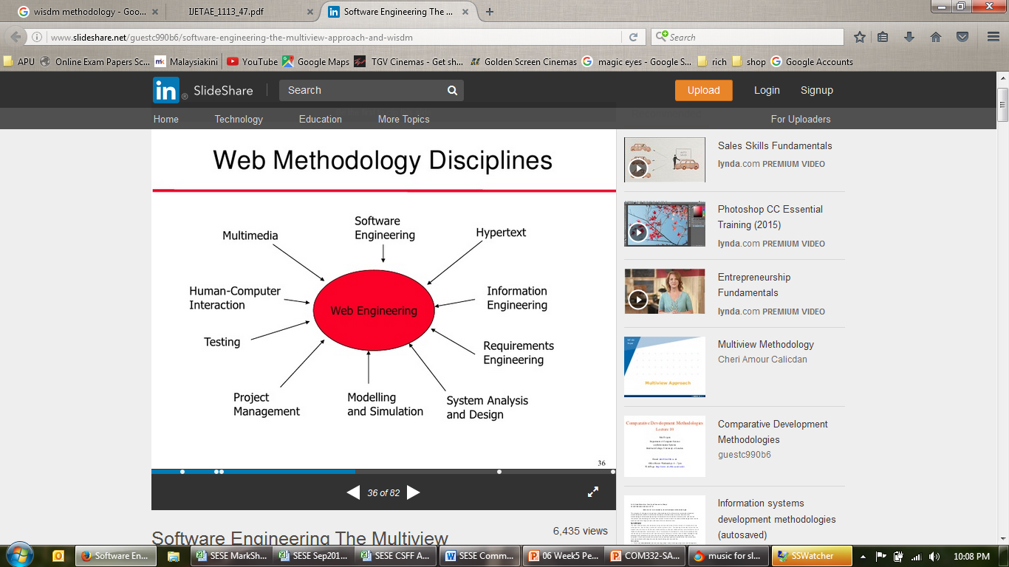
Web Information Systems Development Methodology (WISDM)
Idle for building websites and web application which are very dynamic - incorporates many components, languages and features.
WISDM is based on ‘Multiview’ framework

Slide 9
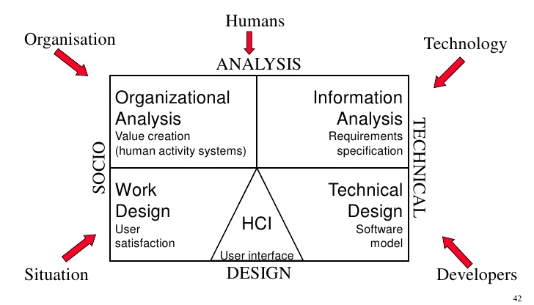
WISDM
Multiview Framework
Multiview looks at a scenario from many view / angle and creates automated design based on the captured tasks.

Slide 10
Knowledge Acquisition and Documentation Structuring (KADS)
Structured way of developing knowledge-based systems (expert systems).
Its components are;
A methodology for managing knowledge engineering projects.
A knowledge engineering workbench.
Methodology for performing knowledge elicitation.
Components in the real world are converted into ‘chunks’ to be designed and turned into automated functions.
Uses Object Oriented approach for designing and construction.
KADS was further developed into CommonKADS.

Slide 11
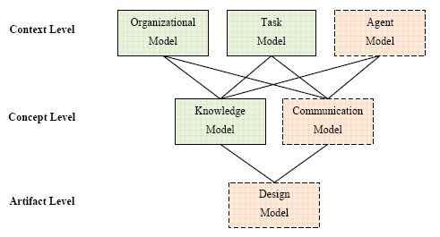
KADS Development Techniques

Slide 12
Soft Systems Methodology (SSM)
An organized way of tackling the messy situation in the real world.
Based on system thinking, a holistic view of the situation
Used when;
Requirements are not clear / cannot be fixed
Scenario of the system are too complex to be defined.
Users not sure how the system should behave.
Soft System - Developer / user not sure of the requirement for the system (System functionality difficult to be determined)
Compared to HARD SYSTEMS where most of the requirements can be determined and fixed.

Slide 13
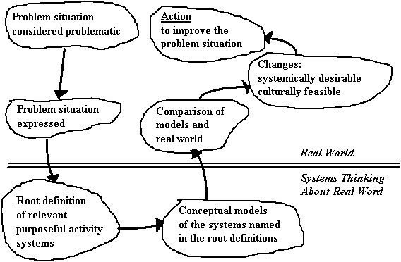
SSM Development Path

Slide 14
SSM Development Techniques
Takes a holistic view of the scenario / situation
Draw a ‘Conceptual Design’ of the scenario
Rich Picture Recommended
Root definitions are produced for each system using the CATWOE criteria
(client, actor, transformation, world-view, owner, environment).
Conceptual Model produced and compared to the real world.
Task to be automated are prioritised using the MoSCoW technique.

Slide 15
Question & Answer

Slide 16
Tutorial
Individual work;
Why do we need to study human behavior when creating a system? What would happen if we don't?
List THREE disadvantages (each) of WISDM, KADS and SSM.
Group Work;
Display the following diagram on the screen and explain to your class how it works;
MULTIVIEW Framework (Slide -8)
KADS Process (Slide – 10)

